Slide 1
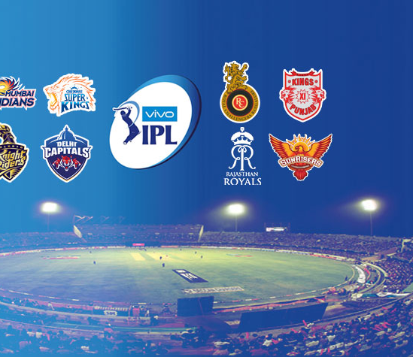
IPL
CRICKET ANALYTICS
By Rahul Sisodia

Slide 2
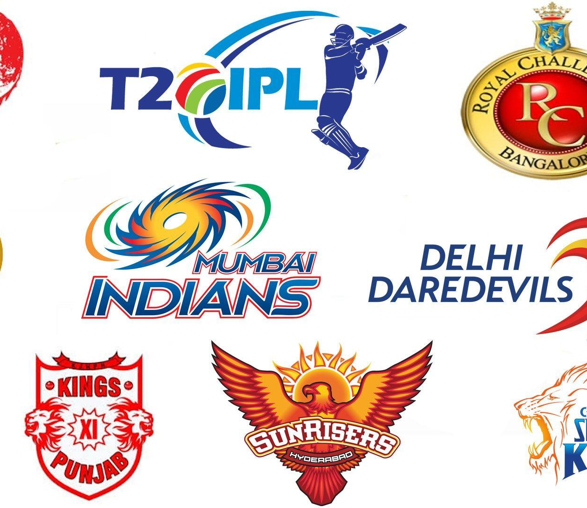
Problem Statement
Perform Exploratory Data Analysis on 'Indian Premiere League'.
As a sports analysts, find out the most successful teams, players and factors contributing win or loss of a team.
Suggest teams or players a company should endorse for its products.

Slide 3
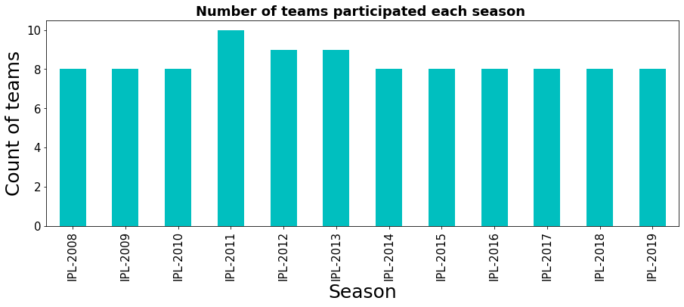
Number of Teams Participated Each Season
In the year of 2011, 2012, 2013, there were 10,9,9 teams participated while in other seasons participated teams were 8.

Slide 4
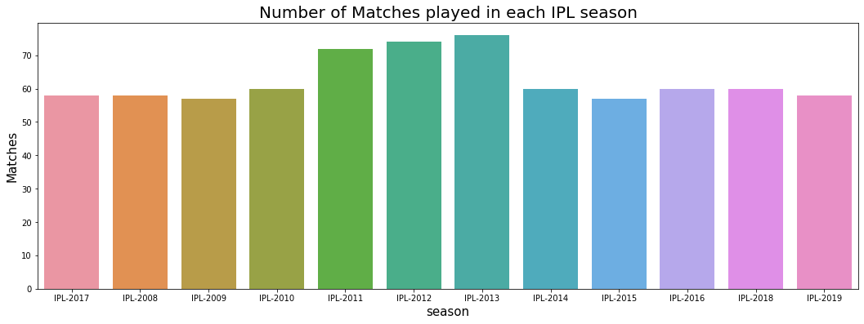
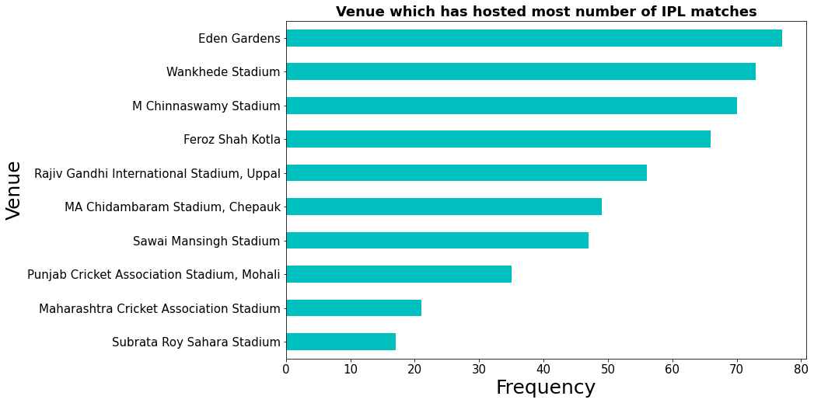
Matches Played in Each Season & Venue which has hosted most number of IPL matches
Eden Gardens has hosted the maximum number of IPL matches.

Slide 5
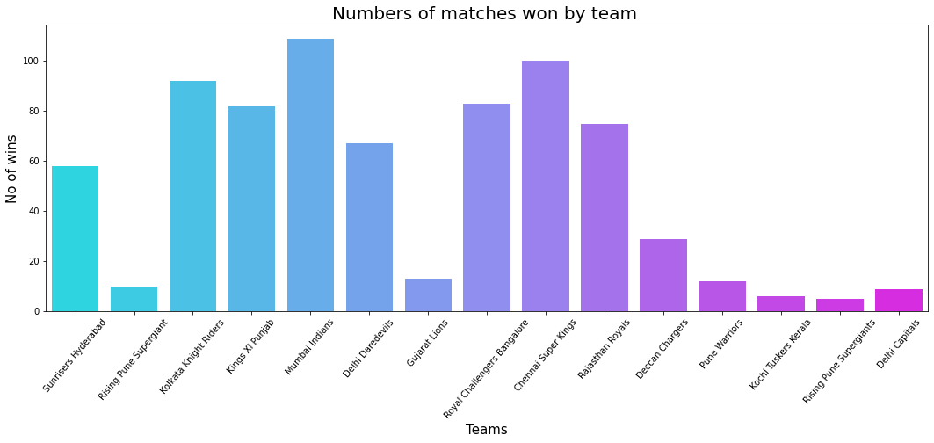
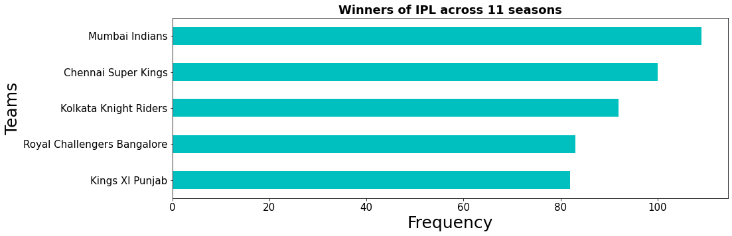
Number of Matches Won by Team
Mumbai Indians has maximum number of winning matches followed by Chennai Super Kings.

Slide 6
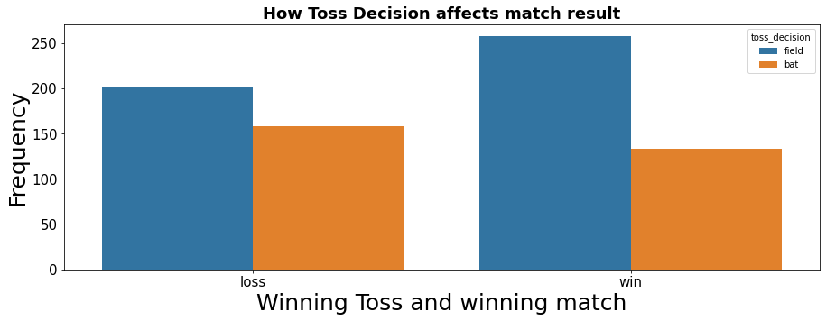
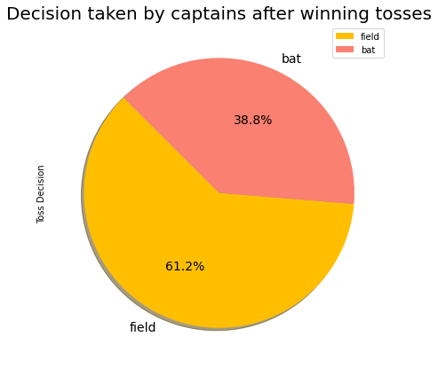
Does teams choose to bat or field first, after winning toss ?
Usually after winning the toss, team choose to field first.
After winning the toss the team who choose to field first has higher probability of winning the match.

Slide 7
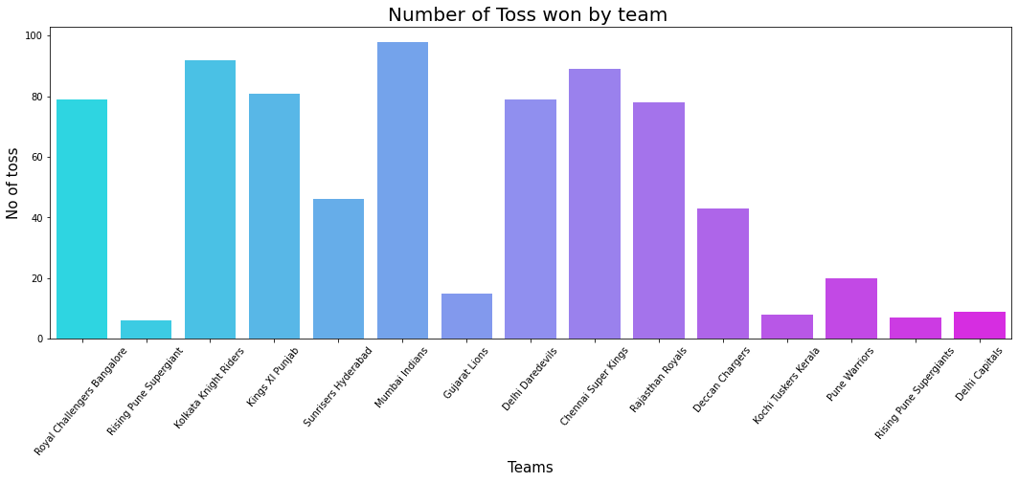
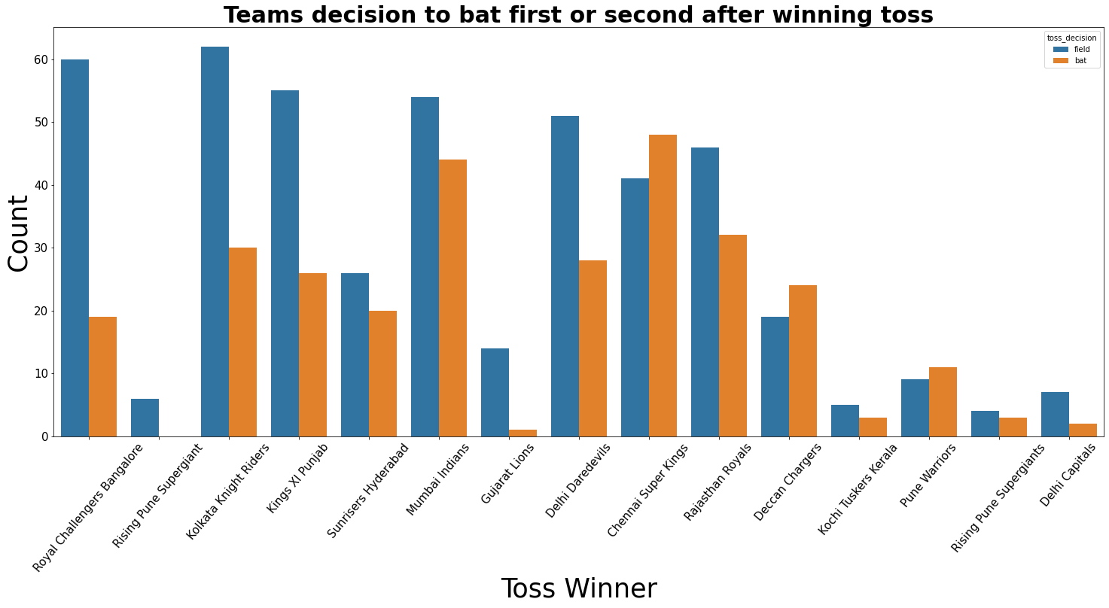
Number of Toss won by individual team & Individual teams' decision to choose bat first or second after winning toss

Slide 8
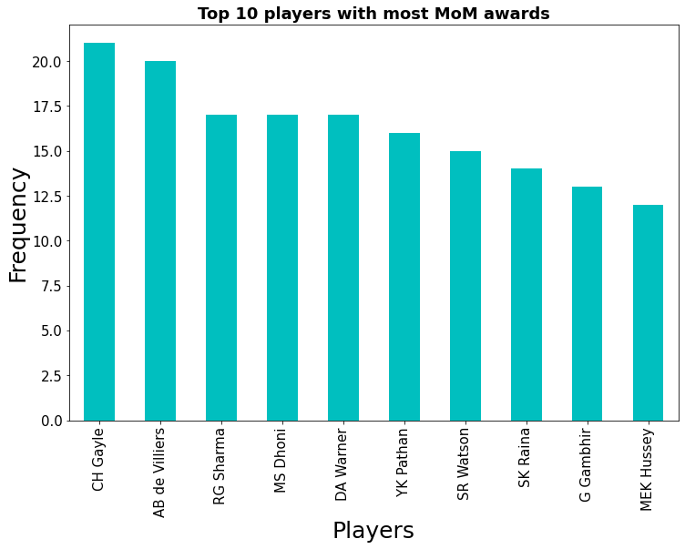
Which player's performance has mostly led team's win
CH Gayle is the most Man of The match for the team followed by AB de Villiers.

Slide 9
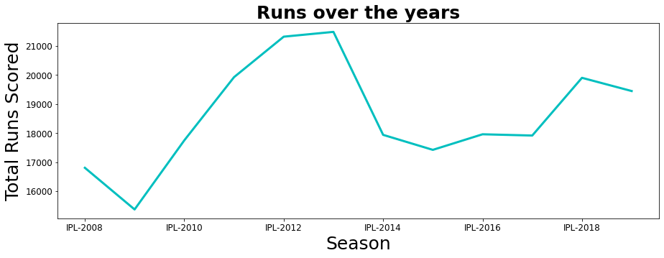
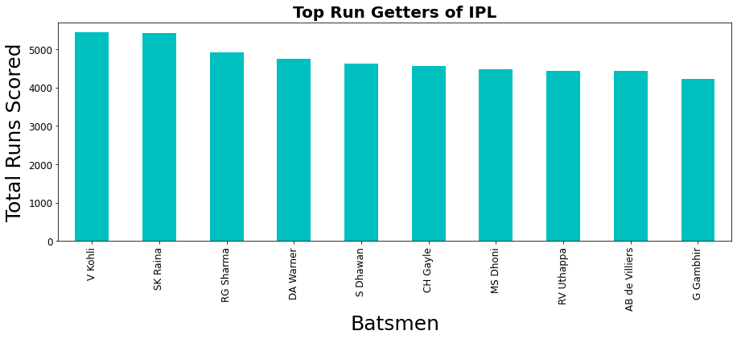
Teams total scoring runs over the years & Top Run Getters of IPL
In IPL season 2012 and season 2013 most runs were scored by teams
Virat Kohli is the top run getter of IPL in all over the seasons

Slide 10
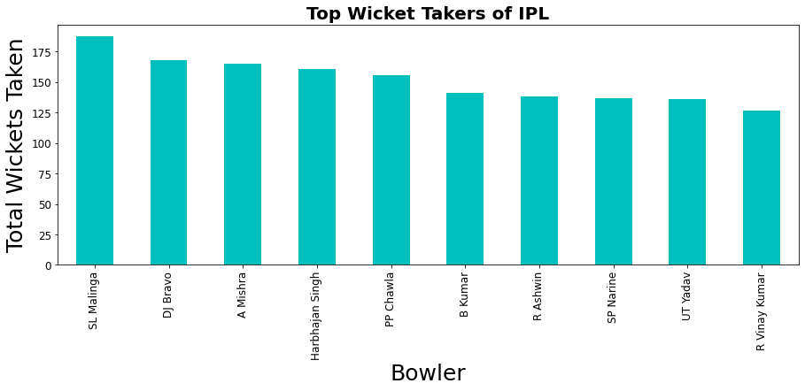
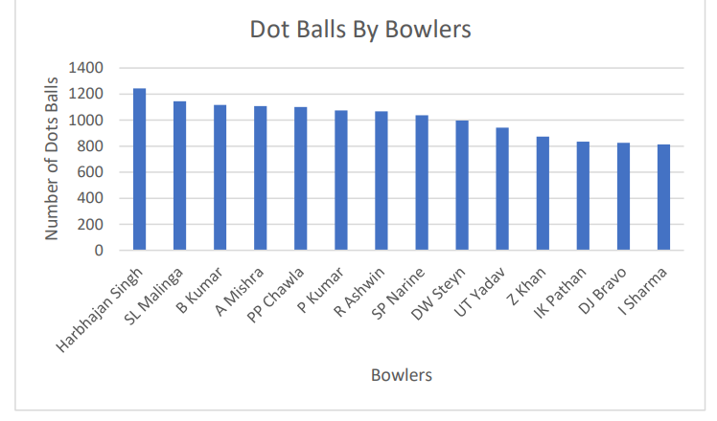
Top wicket takers and most dots balls delivered
SL Malinga is the top wicket taker of IPL
Harbhajan Singh Bowled most dot balls

Slide 11
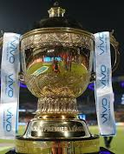
Conclusion As a sports analysts, find out the most successful teams, players and factors contributing win or loss of a team
Mumbai Indians is the most successful team in IPL and has won the most number of toss.
There were more matches won by chasing the total(419 matches) than defending(350 matches).
When defending a total, the biggest victory was by 146 runs(Mumbai Indians defeated Delhi Daredevils by 146 runs on 06 May 2017 at Feroz Shah Kotla stadium, Delhi).
When chasing a target, the biggest victory was by 10 wickets(without losing any wickets) and there were 11 such instances.
The Mumbai city has hosted the most number of IPL matches.
Chris Gayle has won the maximum number of player of the match title.
Eden Gardens has hosted the maximum number of IPL matches.
If a team wins a toss choose to field first as it has highest probability of winning

Slide 12
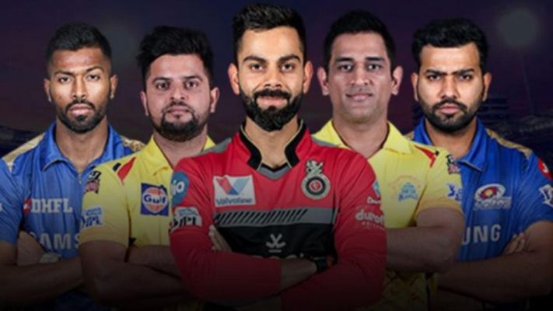
Recommendation Suggest teams or players a company should endorse for its products
If the franchise is looking for a consistent batsman who needs to score good amount of runs then go for V Kohli, S Raina, Rohit Sharma , David Warner...
If the franchise is looking for a game changing batsman then go for Chris Gayle, AB DE Villers, R Sharma , MS Dhoni...
If the franchise is looking for a batsman who could score good amount of runs every match the go for DA Warner, CH Gayle, V Kohli,AB de Villiers's Dhawan
If the franchise needs the best finisher in lower order having good strike rate then go for CH Gayle, KA Pollard, DA Warner's Watson McCullum
If the franchise need a experienced bowler then go for Harbhajan Singh ,A Mishra,PP Chawla ,R Ashwin's Malinga, DJ Bravo
If the franchise need a wicket taking bowler then go for SL Malinga, DJ Bravo, A Mishra ,Harbhajan Singh, PP Chawla
If the franchise need a bowler bowling most number of dot balls then go for Harbhajan Singh's Malinga Kumar, A Mishra, PP Chawla
If the franchise need a bowler with good economy then go for DW Steyn ,M Muralitharan ,R Ashwin, SP Nerine ,Harbhajan Singh.

Slide 13

Thank You for your attention!

